Slide 1
Call of the Nightmare
James Brooks

Slide 2

Introduction
There exists a world spoken of only in legend. On this world, an endless battle takes place at the behest of its ruler, the self-proclaimed king of time and space. Creatures of all kinds are pulled from their homes to participate in its game. Sent to various locations across the universe, these prisoners must now fight for their survival against the hordes of celestial beings.

Slide 3
Description
The goal is survival.
Based off horde mode
Defeat waves of enemies
Encounter large bosses at different stages
Complete the set waves, or survive as long as you can
Restart on death

Slide 4
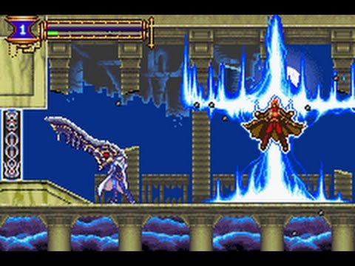
Inspiration
Boss Rush

Slide 5
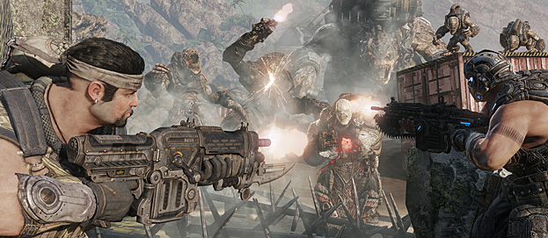
Inspiration
Horde Mode

Slide 6
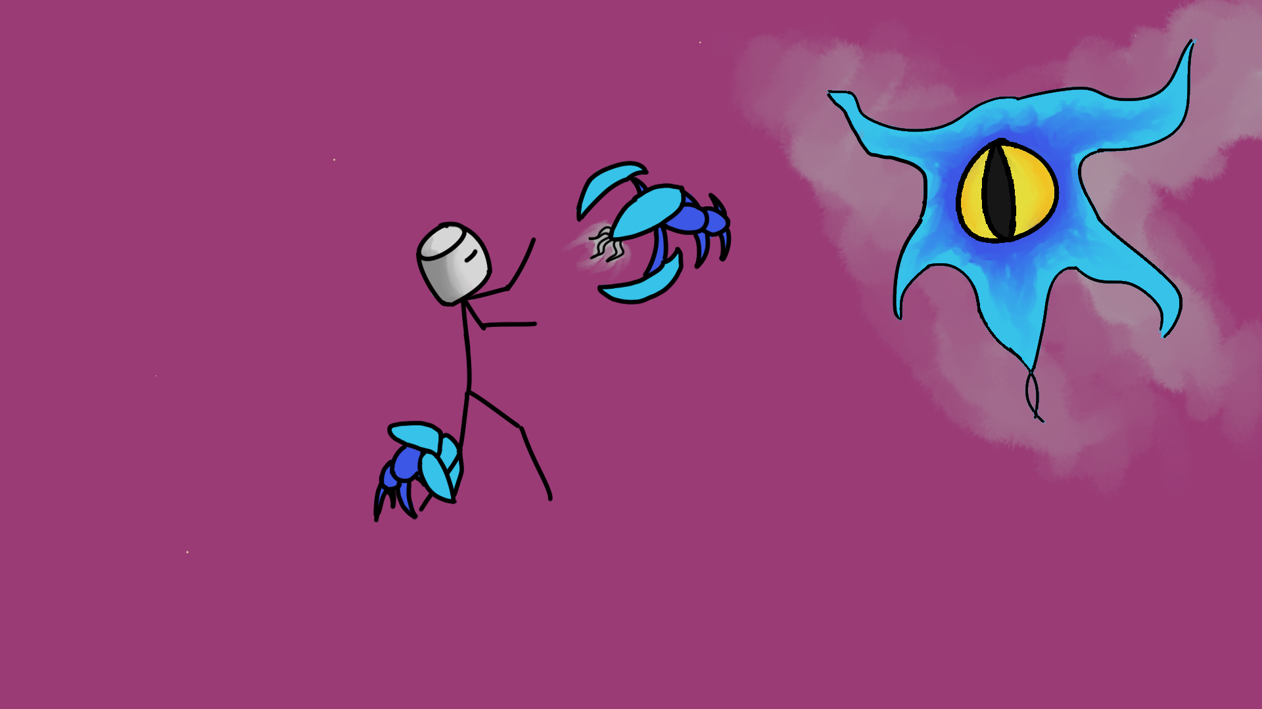
Concept

Slide 7
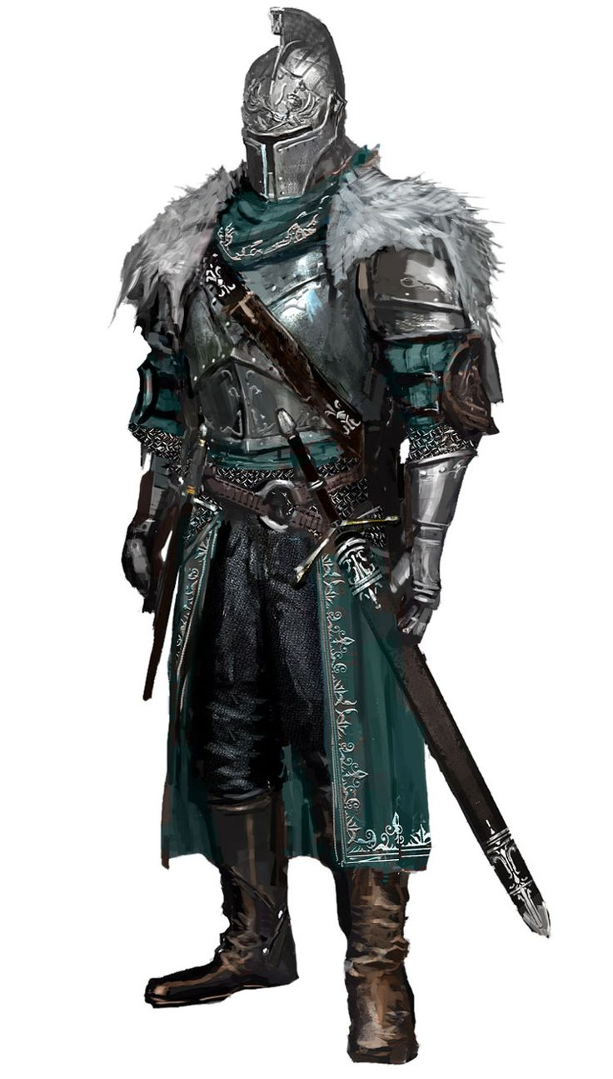
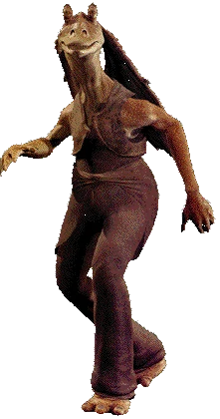

Concept
Notes:
https://i.pinimg.com/736x/8c/0a/d0/8c0ad03d4eda1913f421f45c413e41d5--medieval-knight-medieval-armor.jpg
http://clipartme.com/clipart-me/free-person-13393/
https://vignette.wikia.nocookie.net/jadensadventures/images/3/3d/05ddda40.gif/revision/latest?cb=20140518060032

Slide 8
Key Features / Mechanics
Intelligent AI that works together, even bosses

Slide 9
Key Features / Mechanics
Intelligent AI that works together, even bosses
Co-op

Slide 10
Key Features / Mechanics
Intelligent AI that works together, even bosses
Co-op
Potential for expansion (new maps, monsters, and bosses)

Slide 11
Key Features / Mechanics
Intelligent AI that works together, even bosses
Co-op
Potential for expansion (new maps, monsters, and bosses)
Horde VS

